Slide 1


Team Bocce Ball - Special Olympics Report
By: Benjamin Phillippy, Matthew Chylack, Devin Atkinson, Isaac Wooten, & Jordan Holmqvist

Slide 2
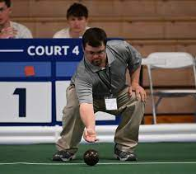
Outline
Our Research Objectives
Environmental Analysis
SWOT Analysis
Data Collection Methods
Data Summarizes
Objective I Conclusions
Objective II Conclusions
Recommendations

Slide 3
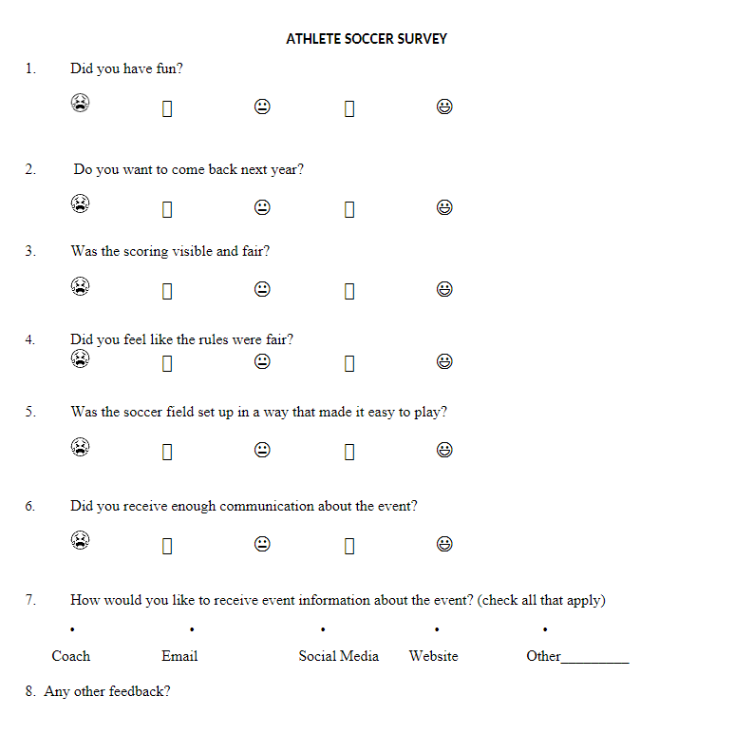
Research Objectives
Objective I
Evaluate overall satisfaction across all measured metrics of athletes and spectators who were surveyed for the 2023 Eastern Fall Sectionals
Objective II
Filter results to only Bocce Ball, and compare metrics against the norm in order to determine areas of improvement specific to Bocce Ball

Slide 4
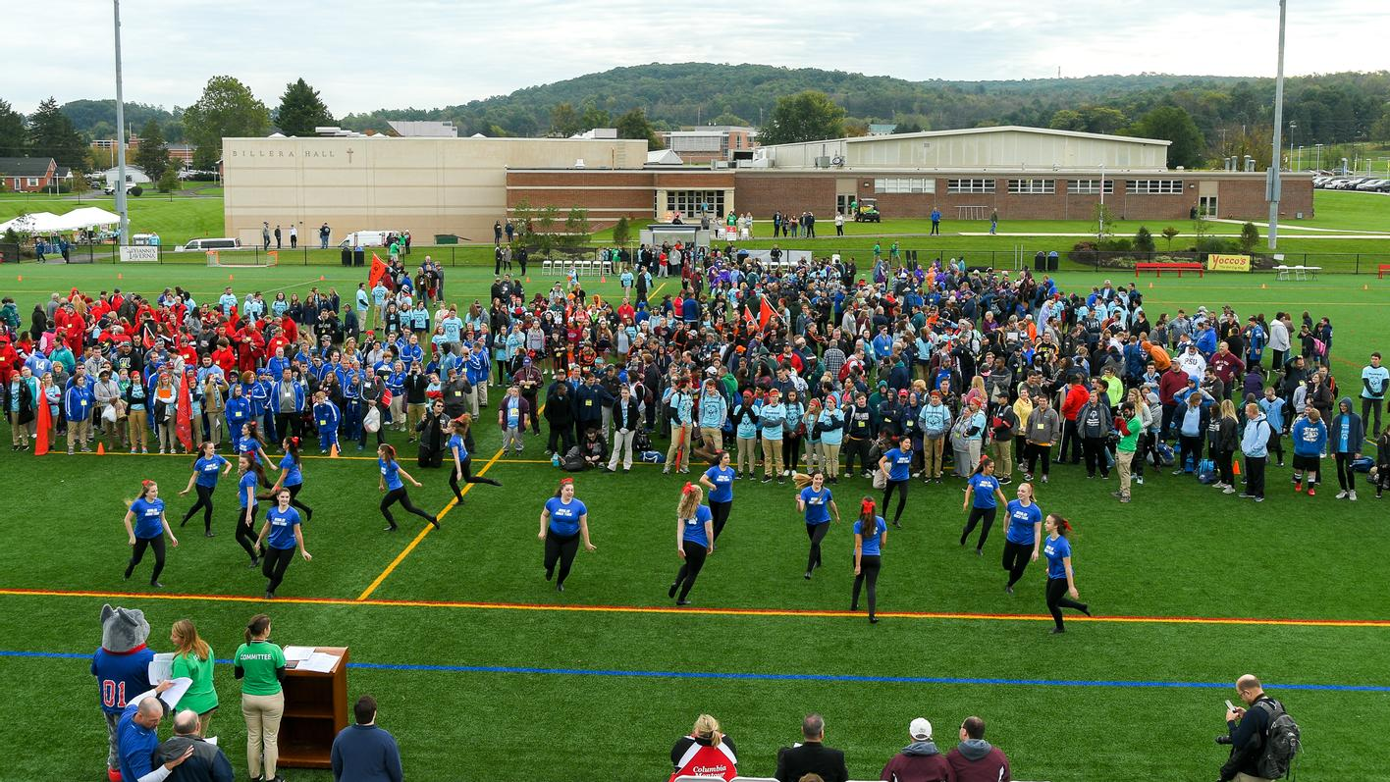
Target Market And Size
DeSales hosted over 800 athletes this year
Individual ranging from 8 years old up to adults
Target market aimed towards younger athletes still in primary schooling
Targeting communities throughout Eastern PA/Mid Atlantic region for Fall Eastern Sectionals

Slide 5
Environmental Analysis
Founded in 1968 by Eunice Shriver
Special Olympics averages near $104.6 million in revenue annually
Competition is present in 193 countries-Over 5 million athletes
Donations, sponsors, volunteerism, and data analysis of participants/spectators have contributed to success
(Become, 2023) & (Major, 2018)

Slide 6
Environmental Analysis
Children and adults are separated into appropriate age and ability groups
Global organization dedicated to providing opportunities for individuals with intellectual disabilities
Promote inclusion to these individuals through sports and competition
Promotion of gender equity in sports
Wide variety of sports to compete in-Powerlifting, Bocce, Cross Country, Soccer, Flag-Football, and Volleyball

Slide 7
SWOT Analysis
Strengths
Plenty of athletes to survey in the same area
Abundance of motivated volunteers
Corporation is exempt from taxes
Breaking down athletes based on abilities
Weakness
Difficult to maneuver through bleachers to survey athletes
Events finishing late
Sports being reffed by volunteers who unfamiliar with the rules
Poor communication about events

Slide 8
SWOT Analysis Continued
Opportunities
Potential to create more event parking
Providing shuttle services to events
Creating more corporate partnerships to spread awareness/obtain more volunteers and participants
Greater participation in surveys from athletes, spectators, and volunteers
Threats
Potential for bad weather
Reliance on donations
Heavy reliance on new volunteers
Injuries incurred by athletes
Inappropriate language or behavior towards anyone participating
Hard feelings over unfairness of rules

Slide 9
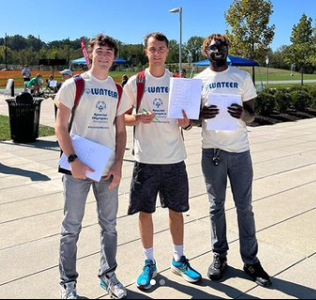
Data Collection Methods
Surveys collected on both Special Olympic athletes and spectators
Approached athletes and spectators at Bocce to ask them to fill out our surveys
Coded data and imported into SPSS
Ran tests to create meaningful visualizations of collected data

Slide 10
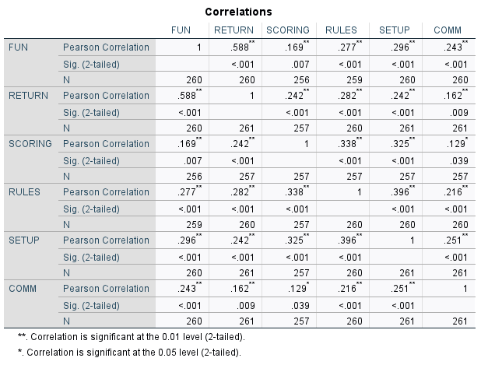
Data Summaries

Slide 11
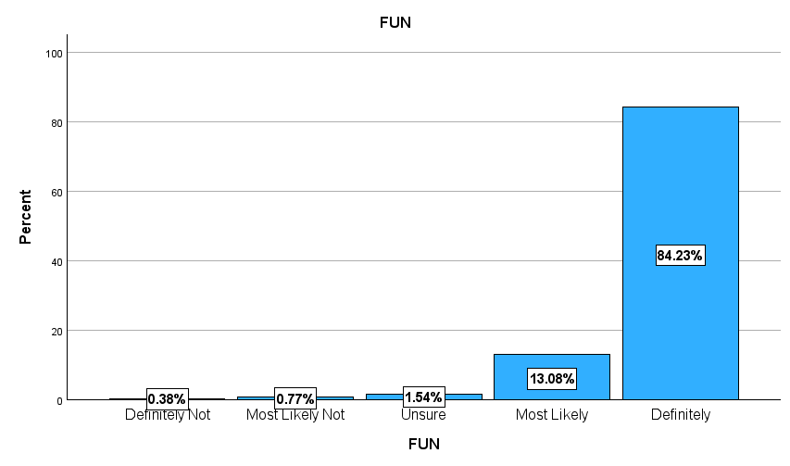
Data Summaries

Slide 12
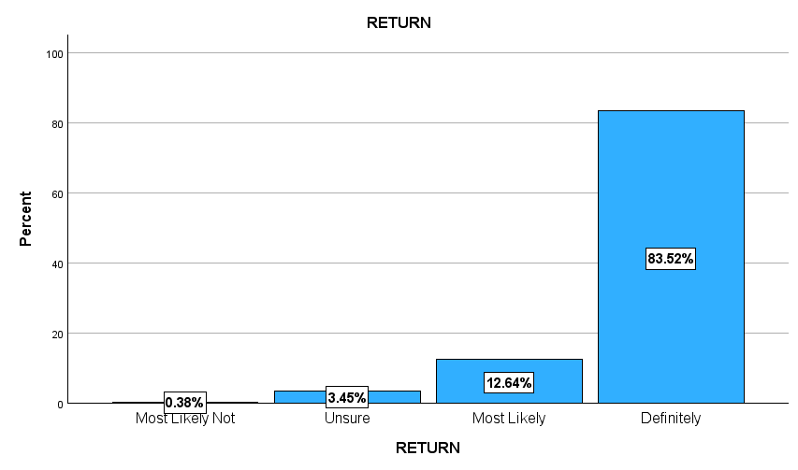
Data Summaries

Slide 13
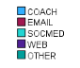
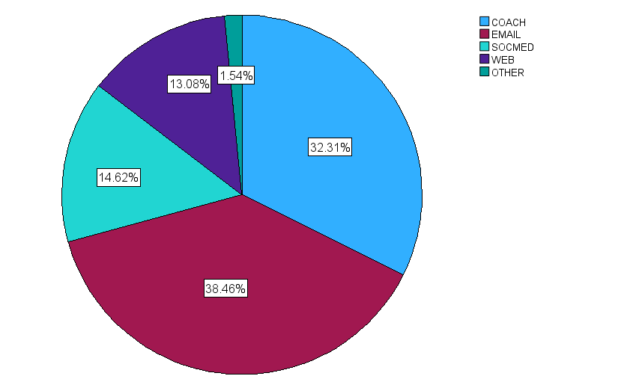
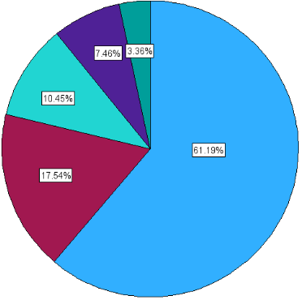
Spectators
Athletes

Slide 14
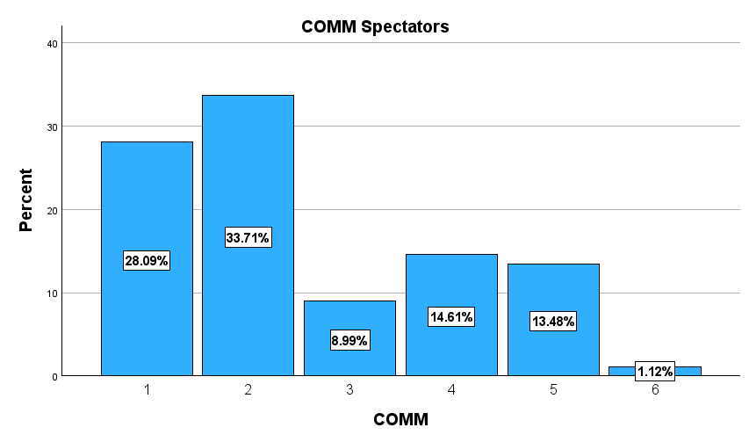
61.8% Negative Result
28.09% Positive Result

Slide 15
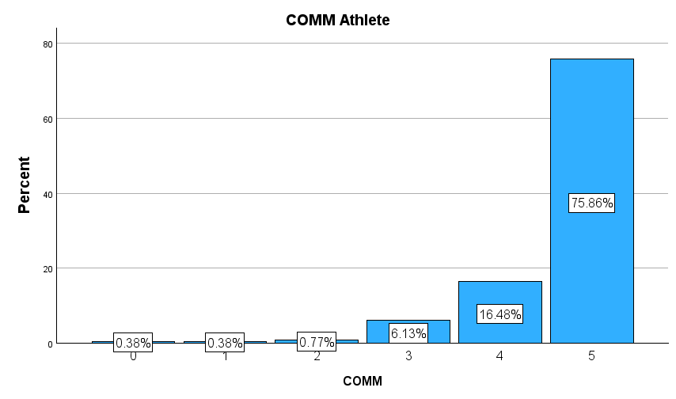
Positive Increases 64.25%
1.15% Negative Result
92.34% Positive Result

Slide 16
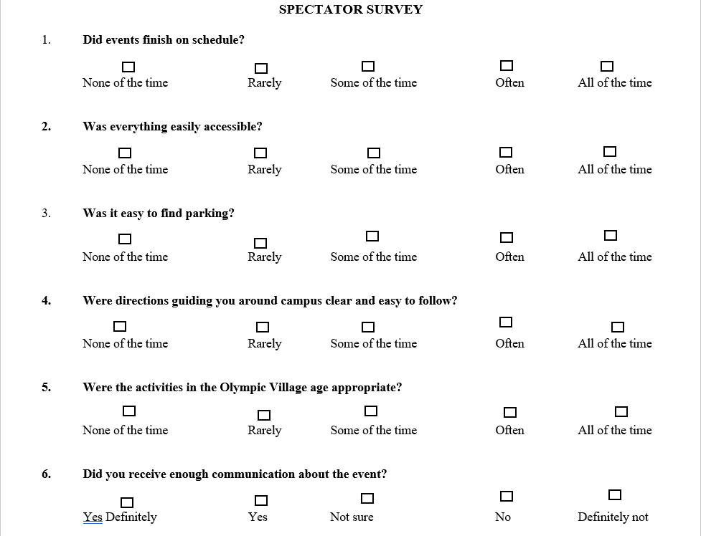

Slide 17
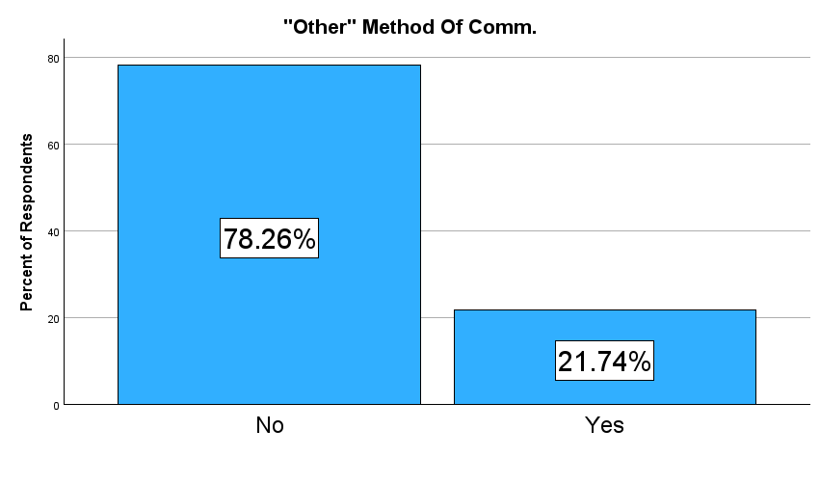
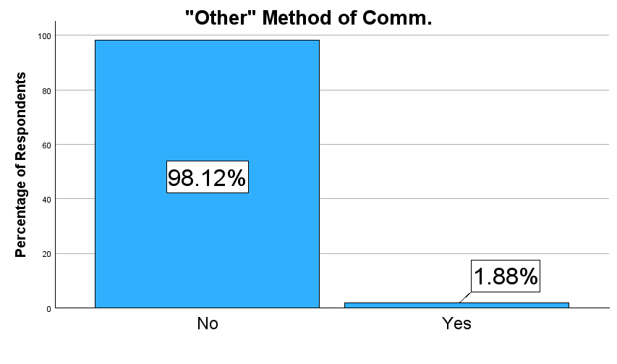
Bocce
All Other Events

Slide 18
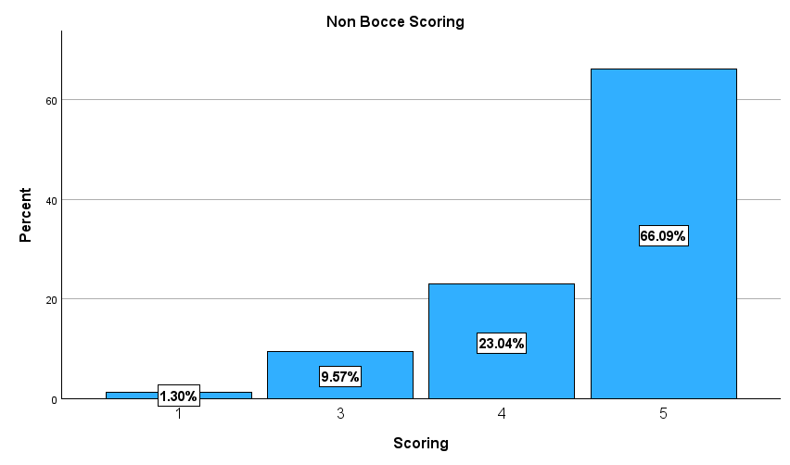
89.13% Positive Result

Slide 19
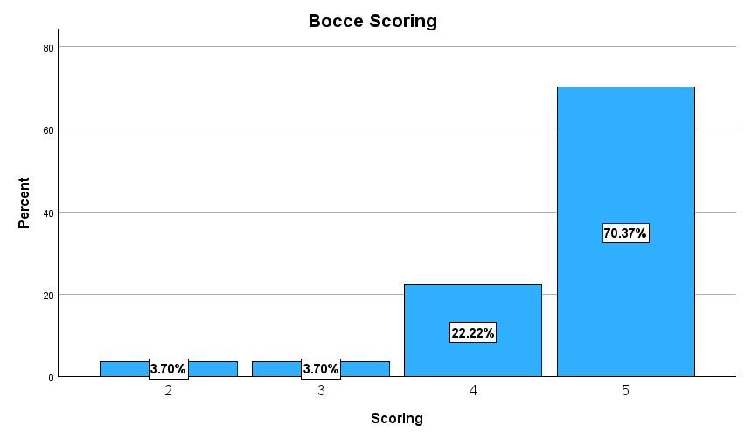
92.59% Positive Scoring
3.46%
Highest Score
4.28%
2nd Highest Score
.82%

Slide 20
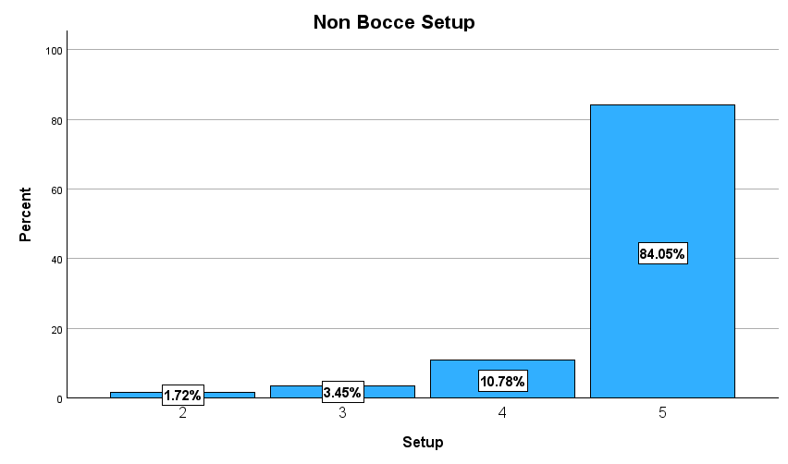
94.73% Positive Result

Slide 21
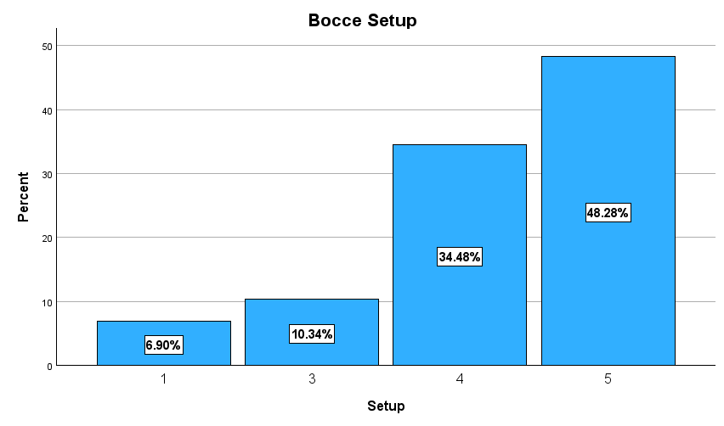
82.76% Positive Scoring
11.97%
Highest Score
35.77%
2nd Highest Score
23.7%

Slide 22
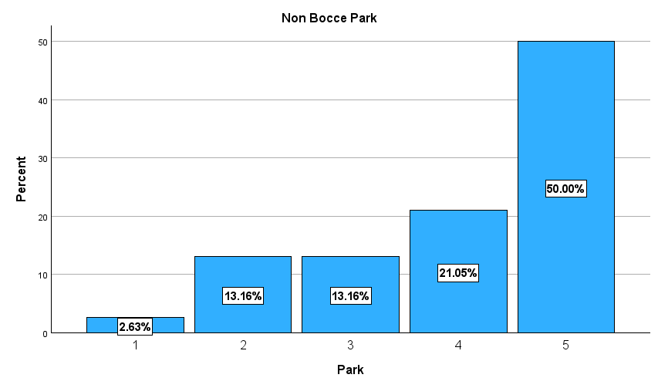
71.05% Positive Result

Slide 23
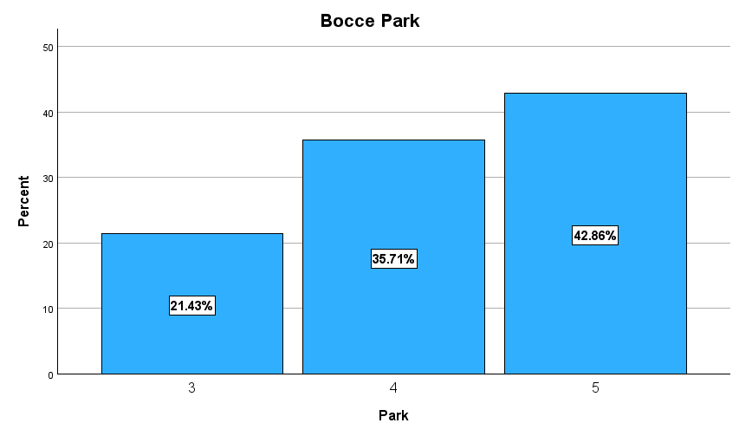
78.57% Positive Scoring
7.52%
Highest Score
7.14%
2nd Highest Score
14.66%

Slide 24
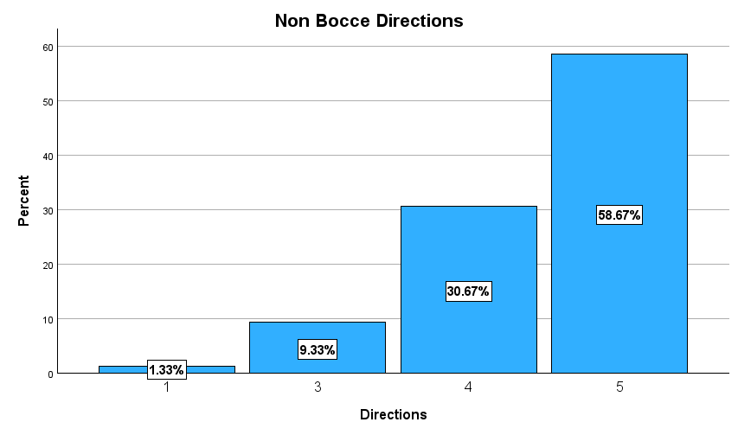
89.34% Positive Result

Slide 25
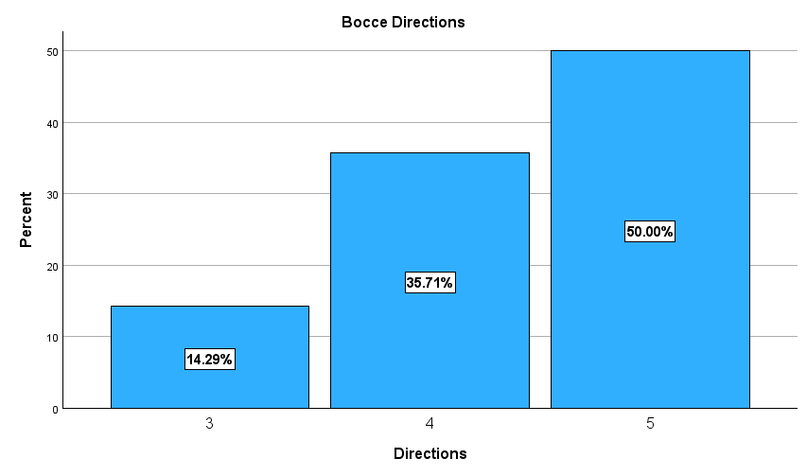
85.71% Positive Scoring
3.63%
Highest Score
8.67%
2nd Highest Score
5.04%

Slide 26
Objective I Conclusion
Evaluate overall satisfaction across all measured metrics of athletes and spectators who were surveyed for the 2023 Eastern Fall Sectionals
97% of athlete’s responded that they had fun
96% said they most likely or definitely plan to return
Athletes primarily use their coach for communication
Spectators were split between using coach and email for communication
Our athletes stated that our communication methods were strong

Slide 27
Objective II Conclusion
Filter results to only Bocce Ball, and compare metrics against the norm in order to determine areas of improvement specific to Bocce Ball
20% of Respondents Used “Other” as a method of communication
Bocce “Scoring” performed strongly and was slightly above average
Bocce “Set Up” considerably underperformed
Parking at and around Bocce measured at average with other sports
Directions for Bocce slightly underperformed

Slide 28
Our 6 Recommendations
Switch response order for question 6 on Spectator survey
Use coaches as most direct communication method to athletes
Use coaches and emails for most effectively relaying event information to spectators
Bocce Set Up could use improvements
Visible time clocks for athletes & greater training for volunteers prior to helping
More signs and directions in and around Billera Hall directing towards Bocce Competition
More concession options near Bocce Ball Competition

Slide 29
Works Cited
Become a special Olympics athlete. (2023). SpecialOlympics.org. https://www.specialolympics.org/get-involved/athlete
Major donors & family foundations. (2018). SpecialOlympics.org. https://www.specialolympics.org/get-involved/partners-of-the-movement/major-donors-family-foundations

Slide 30
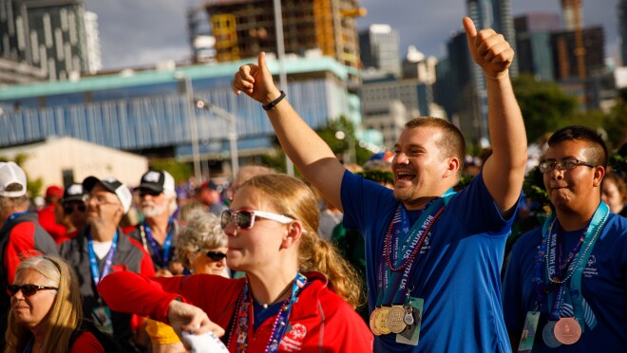
Thank You!

